Slide 1
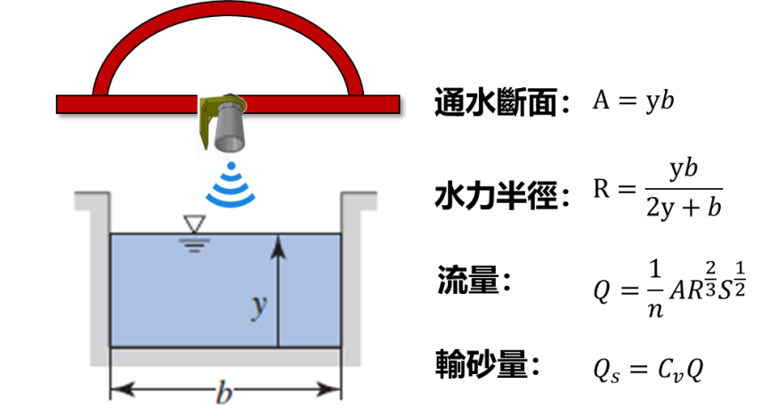
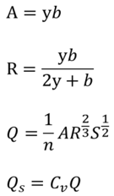
Flow section:
Hydraulic radius:
Flow:
Sediment discharge:

Slide 2
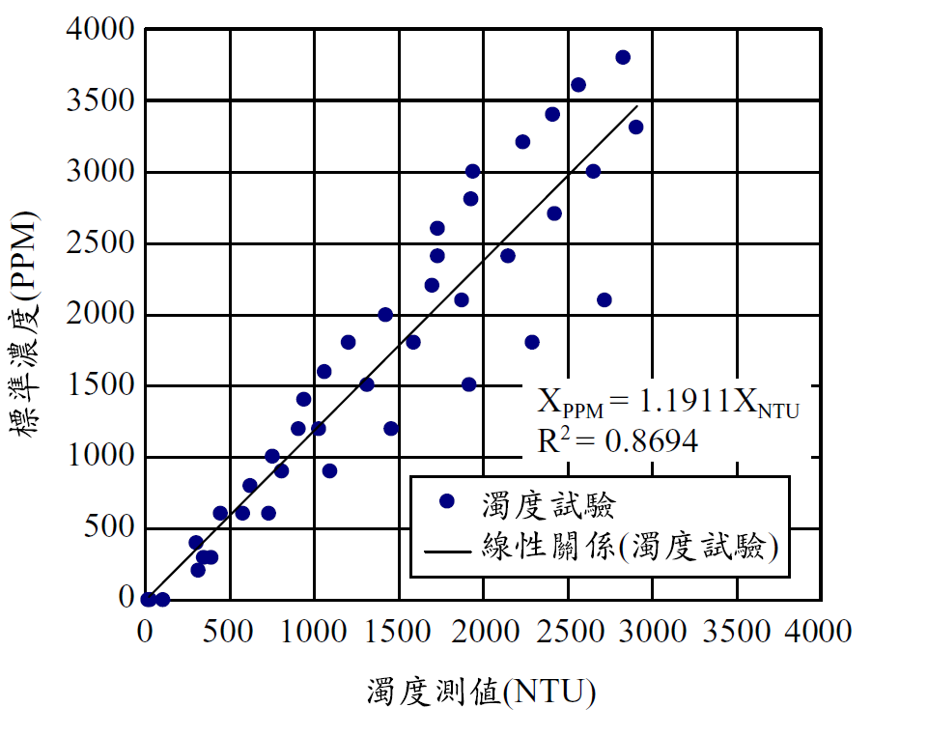
Normal concentration
Turbidity test
Linear regression(Turbidity test)
Turbidity

Slide 3






Hourly
precipitation
Nanhu River Nanhu Bridge
Huan Shan No.3 Bridge
Jing Hua Bridge
Ren Shou Bridge
Water flow
Hourly precipitation
Time
Hourly
precipitation
Nanhu River Nanhu Bridge
Huan Shan No.3 Bridge
Jing Hua Bridge
Ren Shou Bridge
Sediment discharge

Slide 4





Hourly
precipitation
Ma Hai Po Bridge
Rrong Hua
Embankment
Jing Cui Bridge
De Lu Wan Bridge
Water flow
Hourly
precipitation
Ma Hai Po Bridge
Rrong Hua
Embankment
Jing Cui Bridge
De Lu Wan Bridge

Slide 5

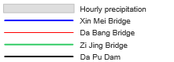
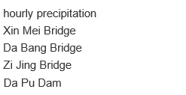
Hourly precipitation
Xin Mei Bridge
Da Bang Bridge
Zi Jing Bridge
Water flow
Da Pu Dam

Slide 6

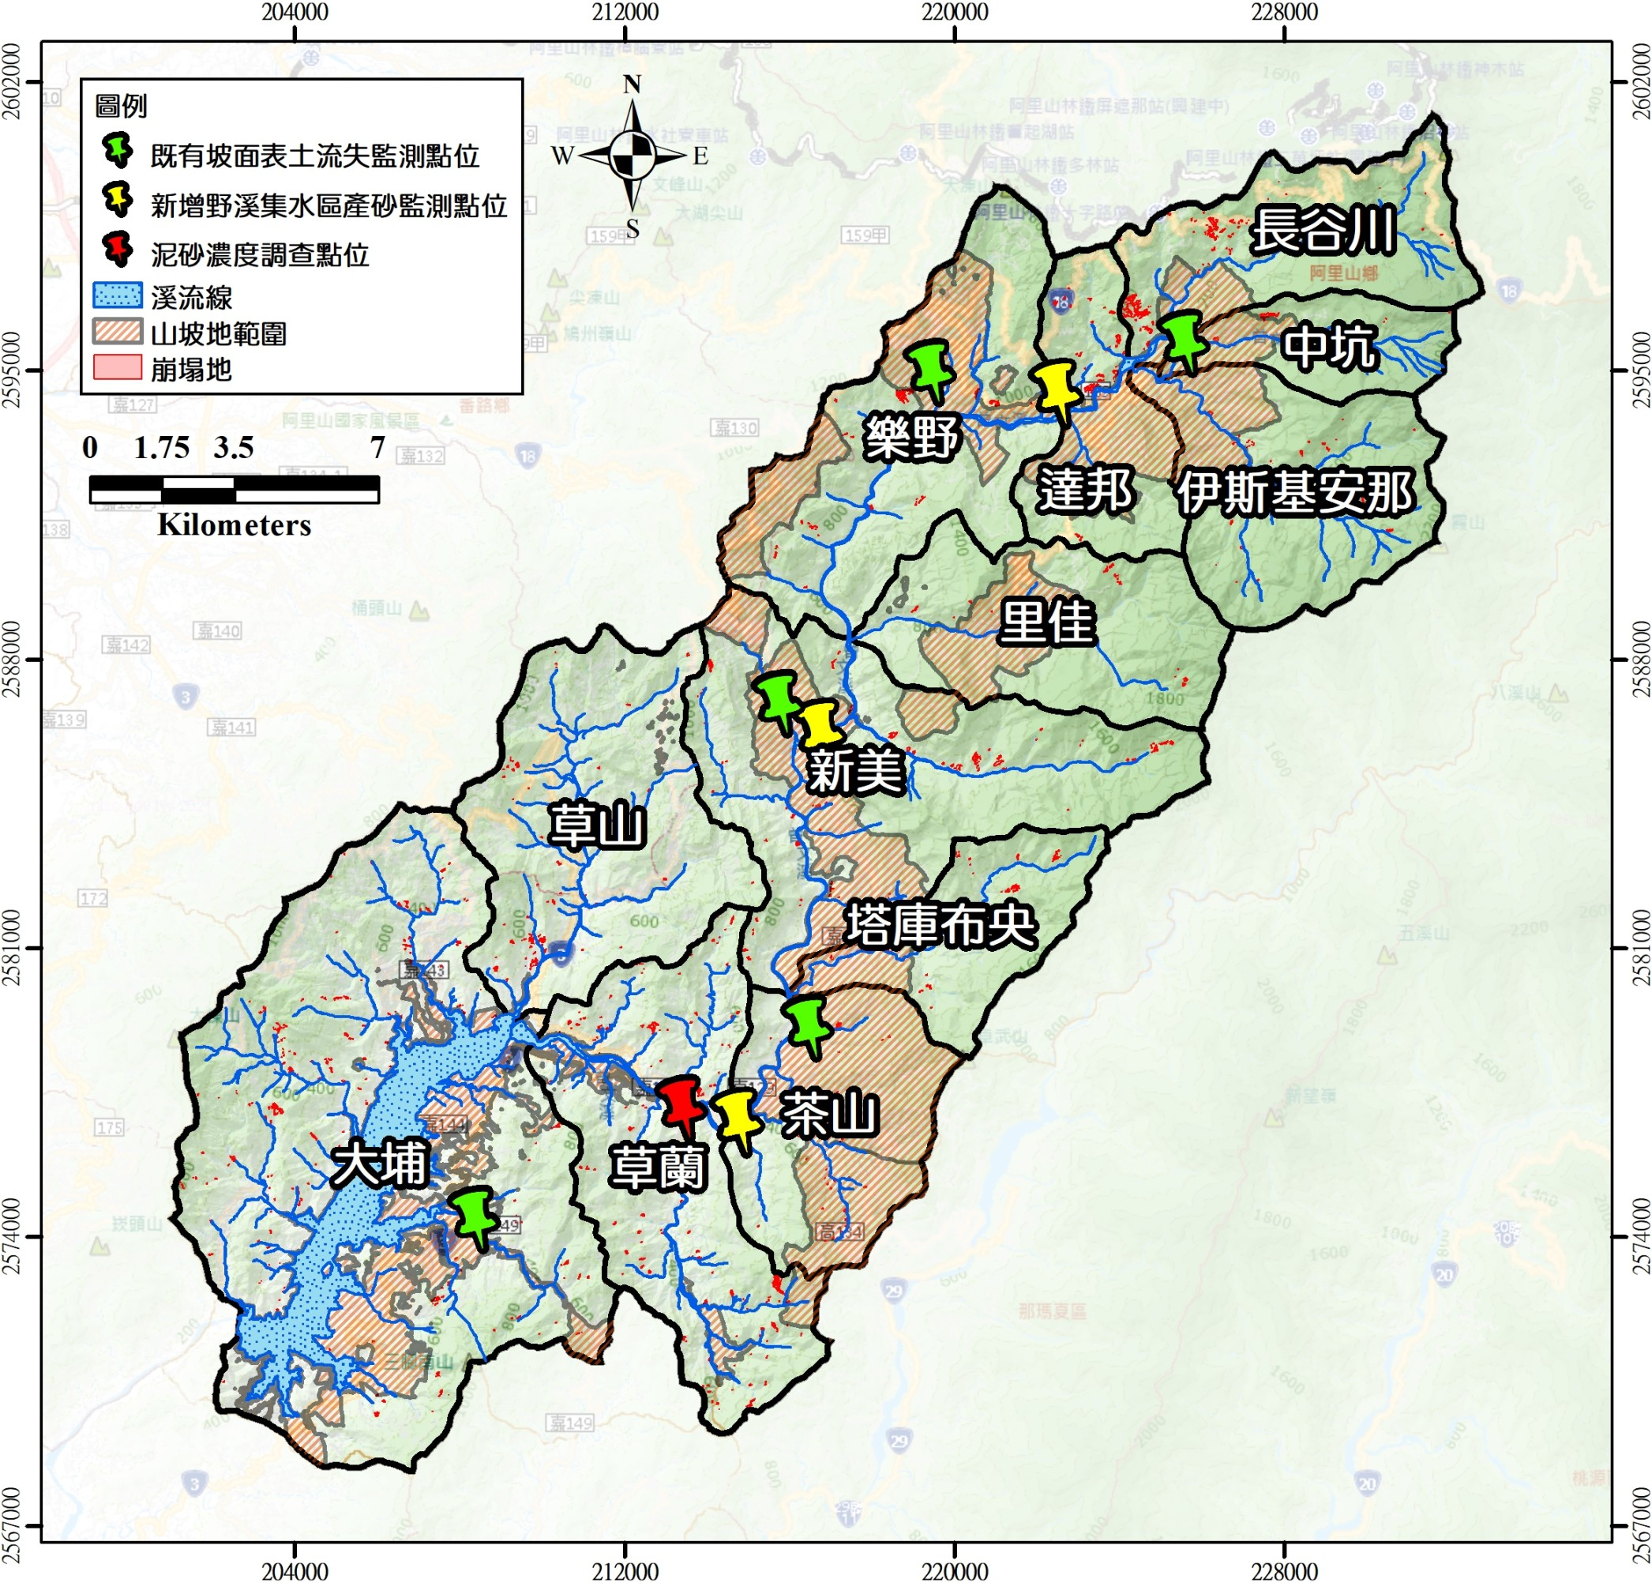

Legend
Soil erosion monitor
Flow and sediment monitor
Chang-Gu-Chuan
Flow and sediment monitor(main stream)
Creek
Slope area
Zhong-Keng
Landslide
Le-Ye
Da-Bang
Yi-Si-Ji-An-Na
Li-Jia
Xin-Mei
Cao-Shan
Ta-Ku-Bu-Yang
Cha-Shan
Da-Pu
Cao-Lan

Slide 7
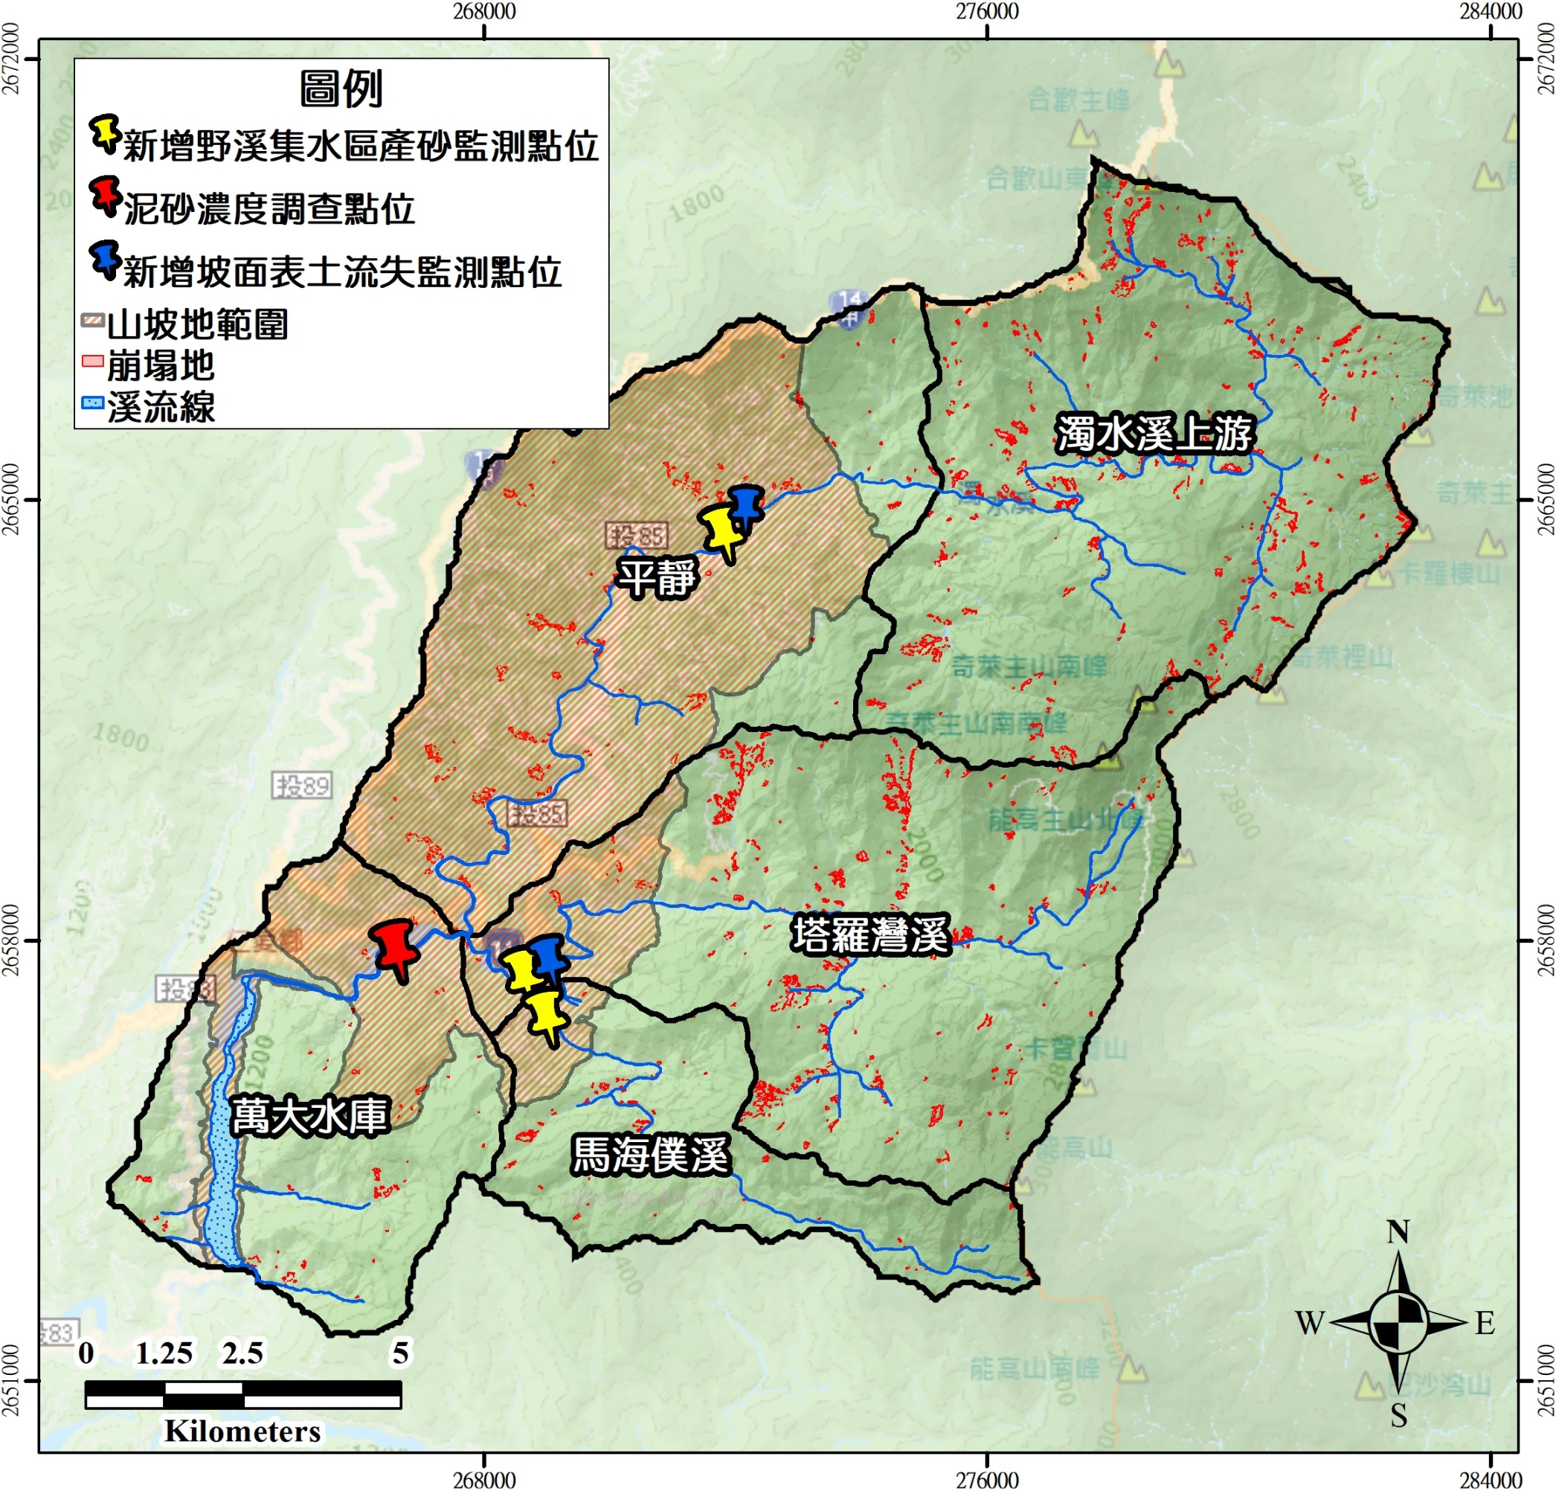
Legend
Flow and sediment monitor
Flow and sediment monitor(main stream)
Flow and sediment monitor(main stream)
Soil erosion monitor
Slope area
Landslide
Creek
Zhuo-Shui river upstream
Ping-Jing
Ta-Luo-Wan river
Wan-Da reservoir
Ma-Hai-Pu river

Slide 8
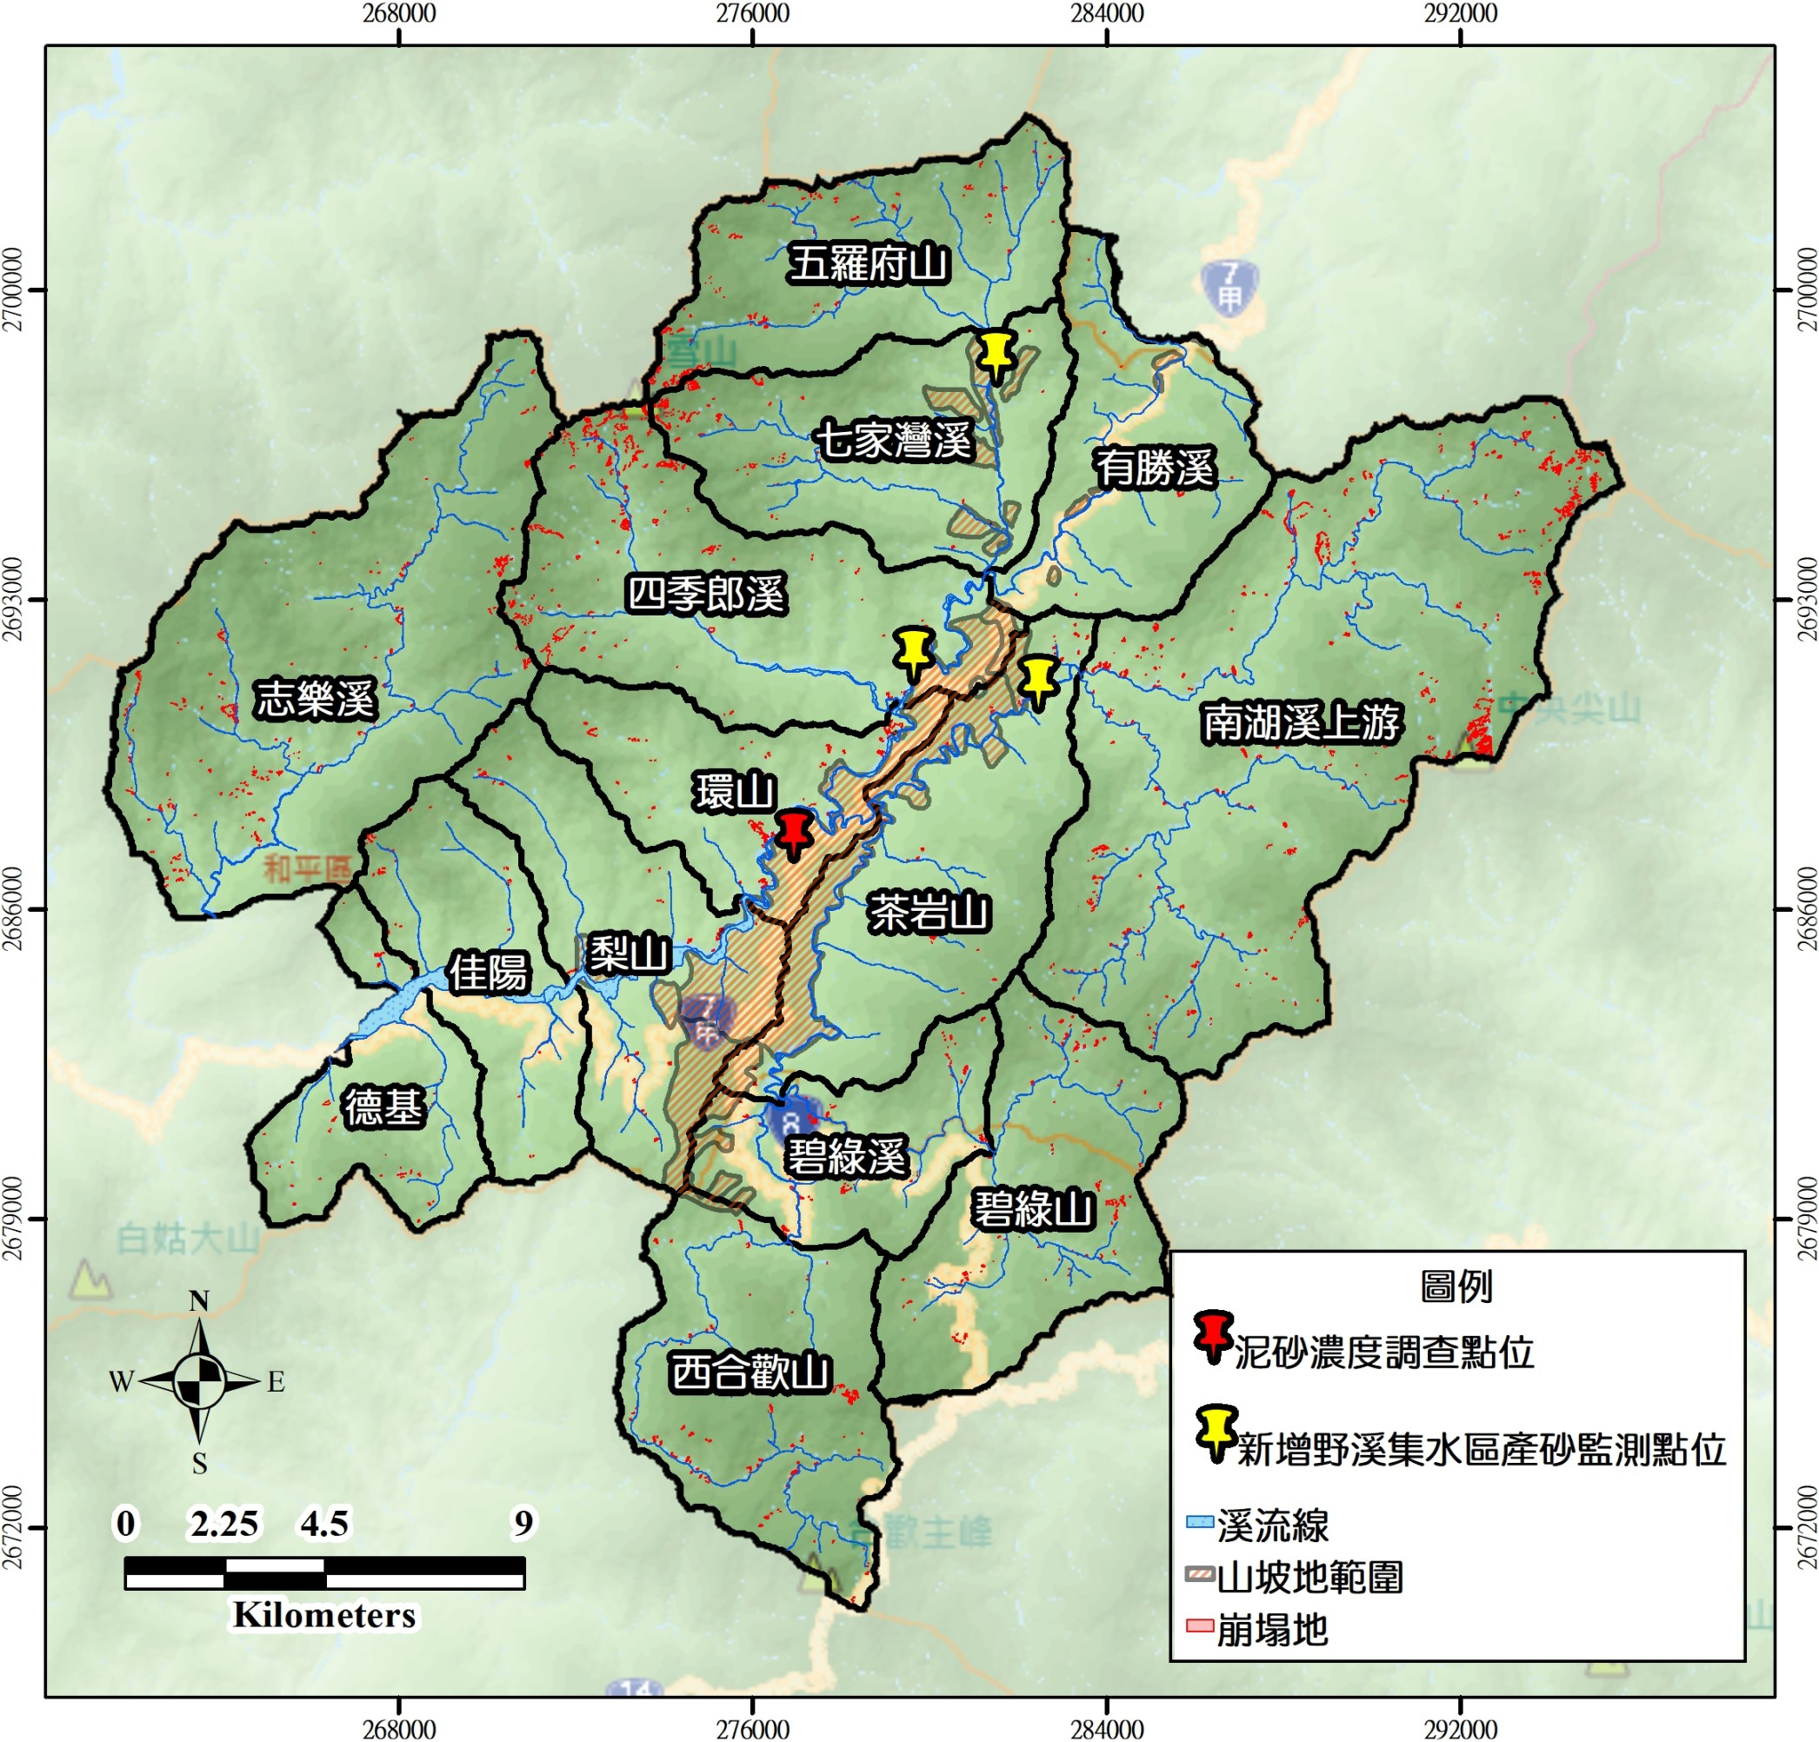
Wu-Luo-Fu Mt.
Qi-Jia-Wan river
You-Sheng river
Si-Ji-Lang Mt.
Zhi-Le river
Nan-Hu river upstream
Huan Mt.
Cha-Yan Mt.
Jia-Yang
Li Mt.
De-Ji
Bi-Lyu river
Bi-Lyu Mt.
Legend
West He-Huan Mt.
Flow and sediment monitor(main stream)
Flow and sediment monitor
Creek
Slope area
Landslide

